Slide 1

Phase IV project: TIME SERIES Modelling
Magali Solimano
OCTOBER 2022

Slide 2
Table of contents
Problem Statement
Goal
Data Understanding
Results
Recommendations
Next Steps

Slide 3
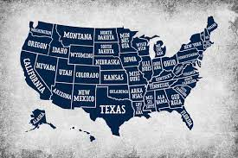
Problem statement
First-time homeowners are looking to identify the top 5 best zip codes to invest in over 5-year period.

Slide 4
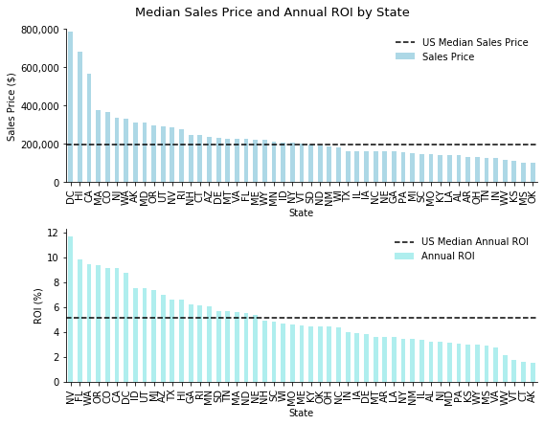
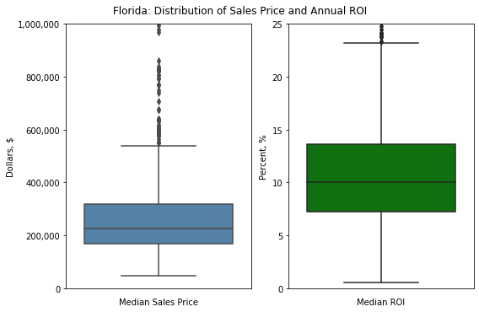
Goal
Identify highest ROI zipcodes with below-median sales price in state of Florida, which has high percentage of zipcodes that meet this criteria.

Slide 5
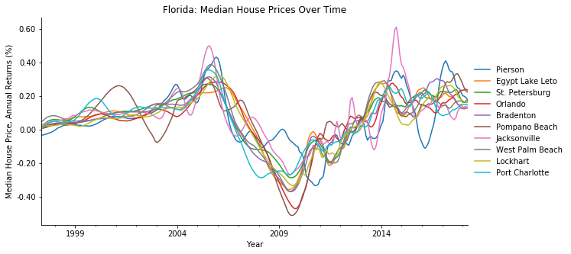
Data understanding
Data
Zillow Research Data
Methods
Descriptive data analysis and statistics
Nearly 15,000 zipcodes
Time series modelling
270 monthly time series

Slide 6
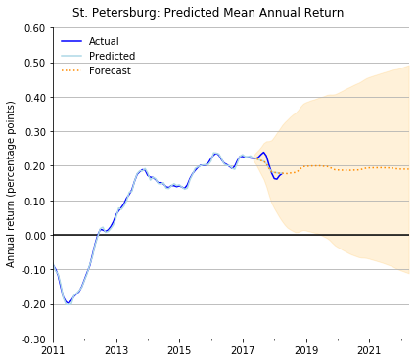
results
SARIMAX model was run and fit on ten zipcodes
5y forecasts:
Overfitting: training data performed better than test data
Wide confidence intervals, indicating uncertainty

Slide 7
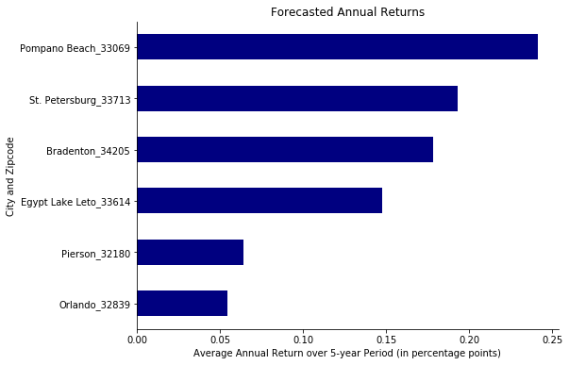
recommendations
Invest in zipcodes:
Pompano Beach (Miami metro)
St. Petersburg (Tampa metro)
Bradenton (Bradenton/Sarastota metro)
Egypt Lake Leto (Tampa metro)

Slide 8


NEXT STEPS: extended analysis
Model improvements should take into account external factors (mortgage rates, economic conditions)
Focus analysis on post-2008 housing crisis period

Slide 9
Thank you
For questions, contact:
Magali Solimano
magali.solimano@gmail.com

